Slide 1
Data Science with Python CS 498 (Special Topics in Computer Science) Pandas Python and data analysis
Dr. Malak Abdullah
Computer Science Department
Jordan University of Science and Technology

Slide 2
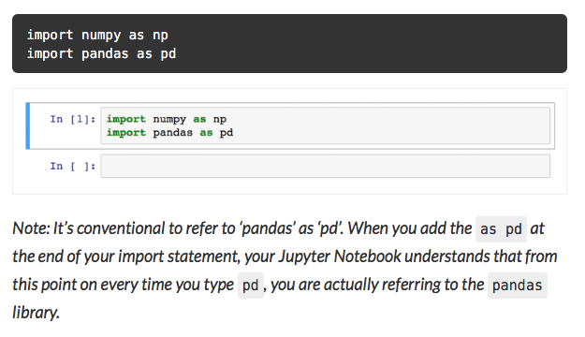
What Is Pandas?
Pandas is one of the most popular Python libraries for Data Science and Analytics.
It is built on top of Numpy. This means that Numpy is required by pandas
It’s the “SQL of Python.” Why? Because pandas helps you to manage two-dimensional data tables in Python.
pip install pandas

Slide 3
Pandas data structures
There are two types of data structures in pandas: Series and DataFrames:
Series: a pandas Series is a one dimensional data structure (“a one dimensional ndarray”) that can store values — and for every value it holds a unique index, too.
DataFrame: a pandas DataFrame is a two (or more) dimensional data structure – basically a table with rows and columns. The columns have names and the rows have indexes.

Slide 4
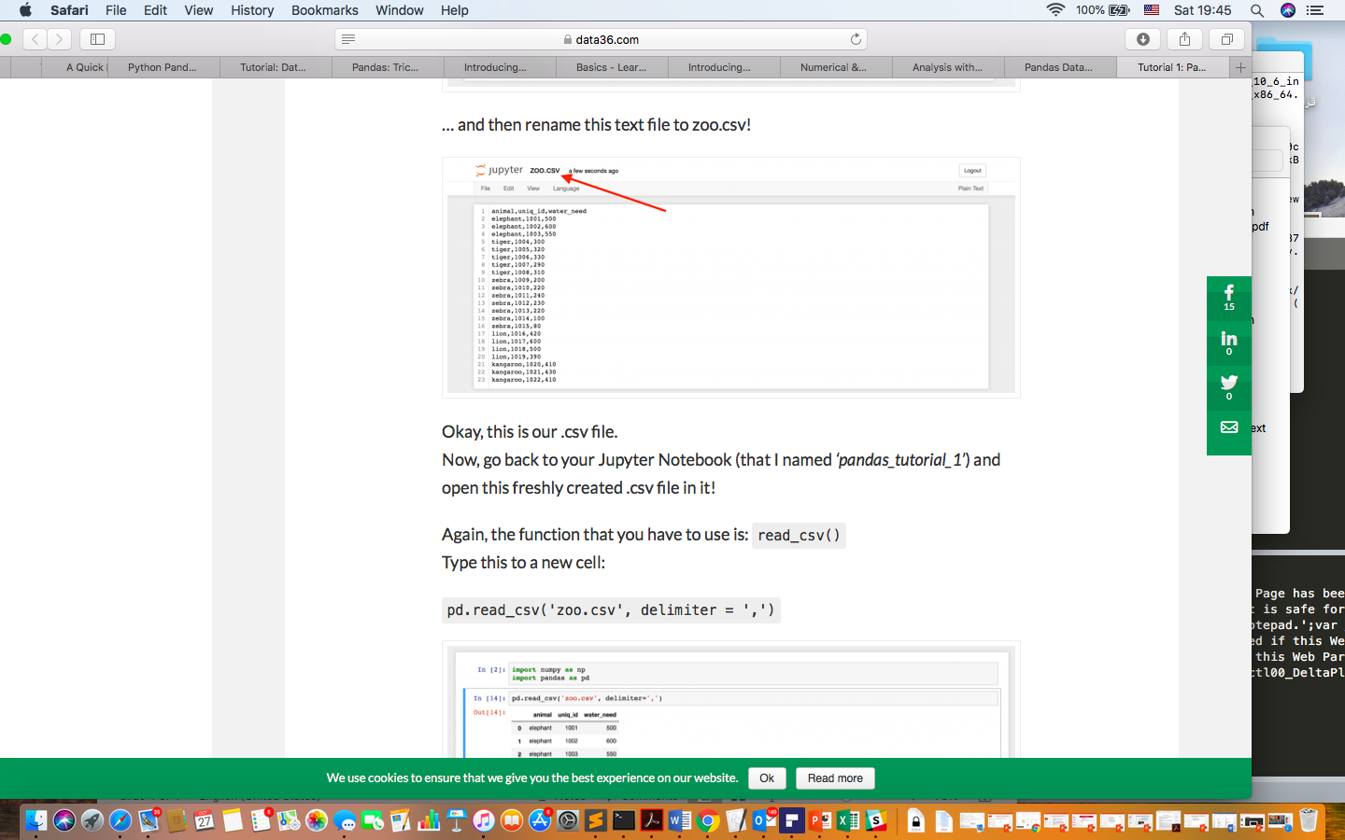
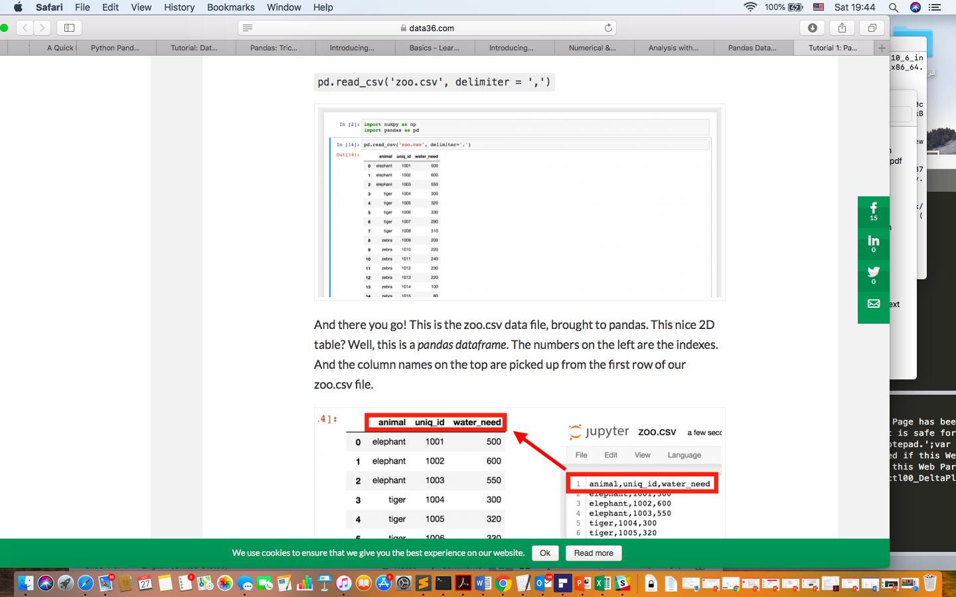
Loading a .csv file into a pandas DataFrame
There is a function for it, called read_csv()
The numbers on the left are the indexes. And the column names on the top are picked up from the first row of our zoo.csv file.

Slide 5
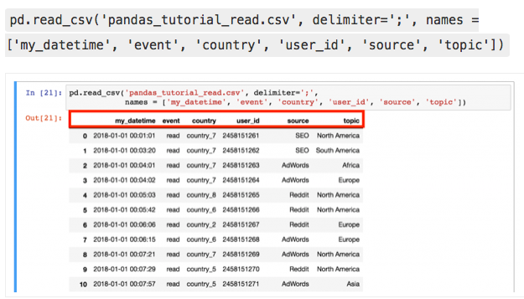
Changing the name of the columns

Slide 6
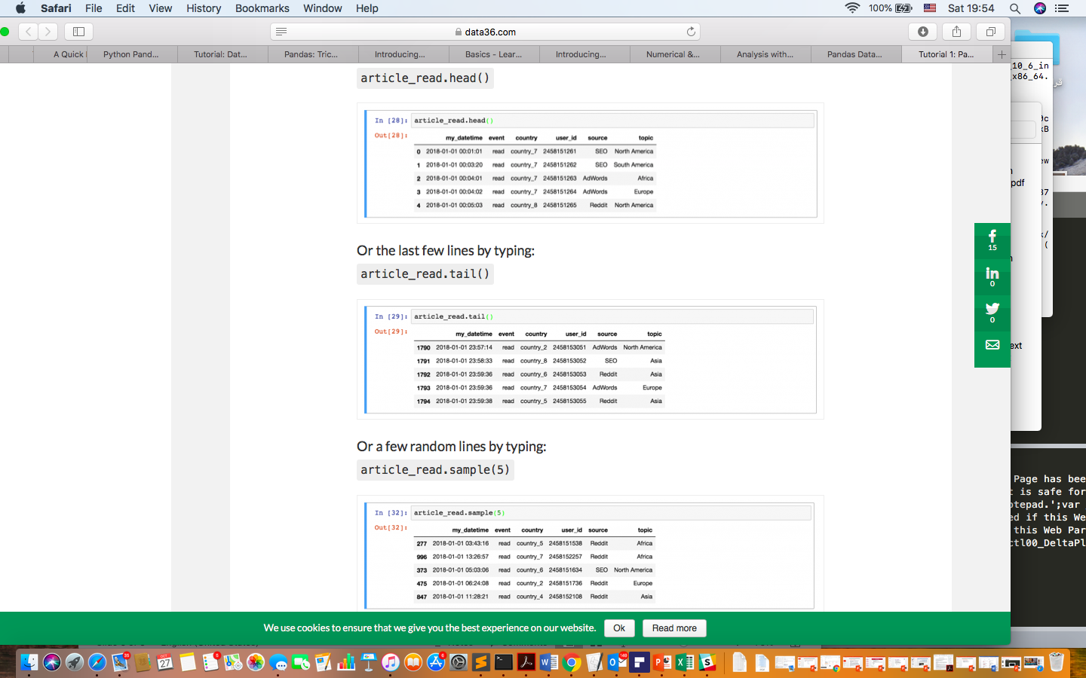
Print a sample of your dataframe
article_read = pd.read_csv('pandas_tutorial_read.csv', delimiter=';', names = ['my_datetime', 'event', 'country', 'user_id', 'source', 'topic’])

Slide 7
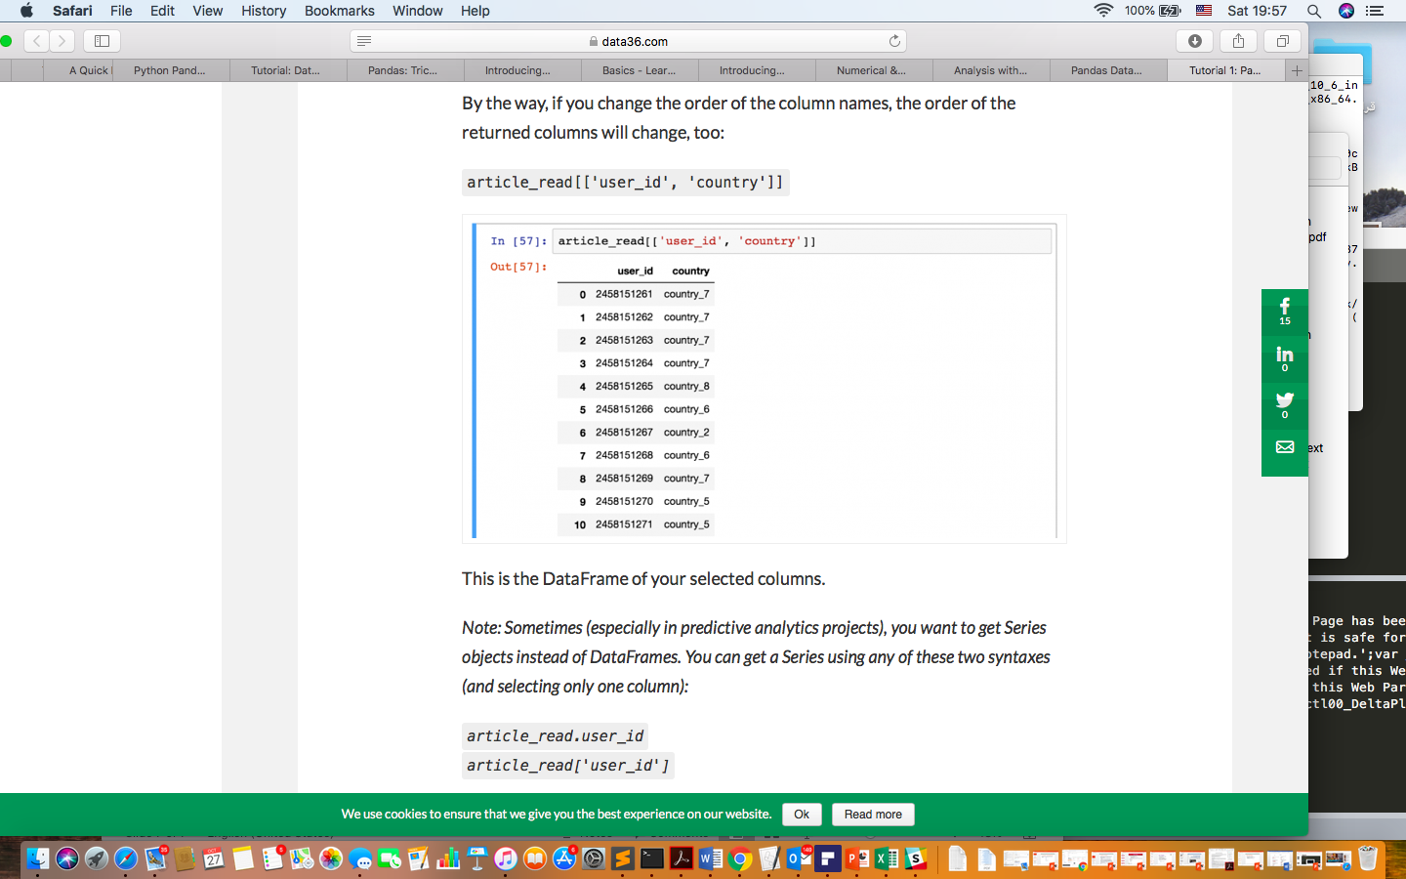
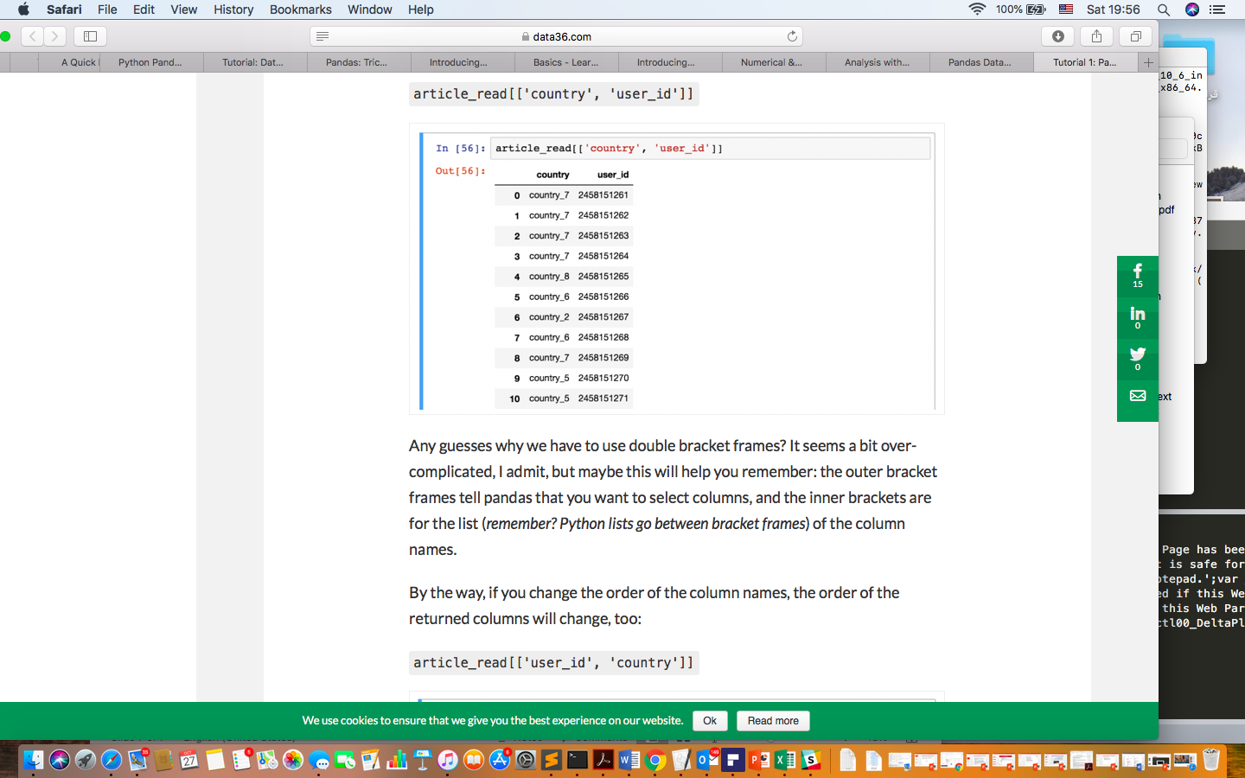
Select specific columns of your dataframe

Slide 8

You can retrieve by using the following syntax

Slide 9
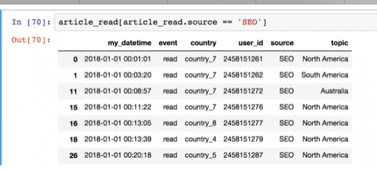
Filter for specific values in your dataframe
Let’s say, you want to see a list of only the users who came from the ‘SEO’ source. In this case you have to filter for the ‘SEO’ value in the ‘source’ column:
article_read[article_read.source == 'SEO’]
is the article_read.source column’s value 'SEO' or not? The results are boolean values (True or False).
Then from the article_read table, it prints every row where this value is True and doesn’t print any row where it’s False.

Slide 10
Functions can be used after each other
E.g. combine these two selection methods:
article_read.head()[['country', 'user_id’]]
The same as:
article_read[['country', 'user_id']].head()

Slide 11

Data aggregation – in practice
let’s do five things with this data:
Let’s count the number of rows (the number of animals) in zoo!
Let’s calculate the total water_need of the animals!
Let’s find out which is the smallest water_need value!
And then the greatest water_need value!
And eventually the average water_need!

Slide 12
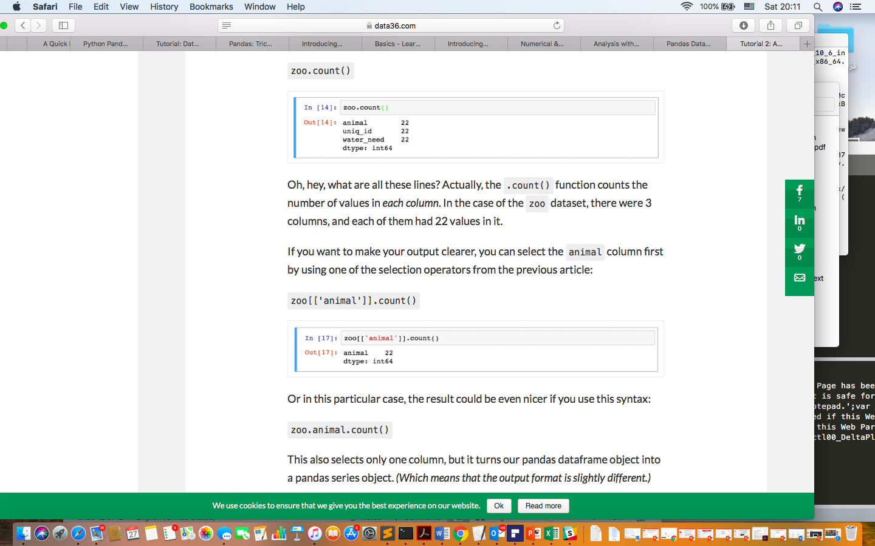
Pandas Data Aggregation: .count() .sum() .min() .max()
zoo[['animal']].count()
zoo.animal.count()

Slide 13
Pandas Data aggregation #5 and #6: .mean() and .median()

Slide 14
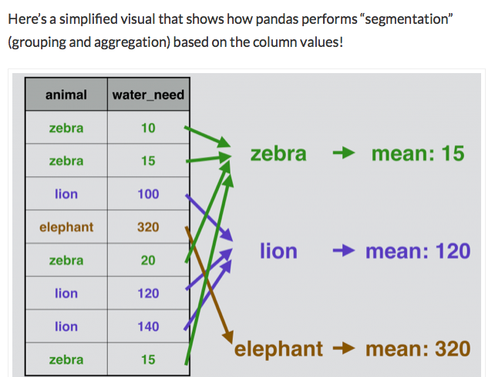
Grouping in pandas

Slide 15
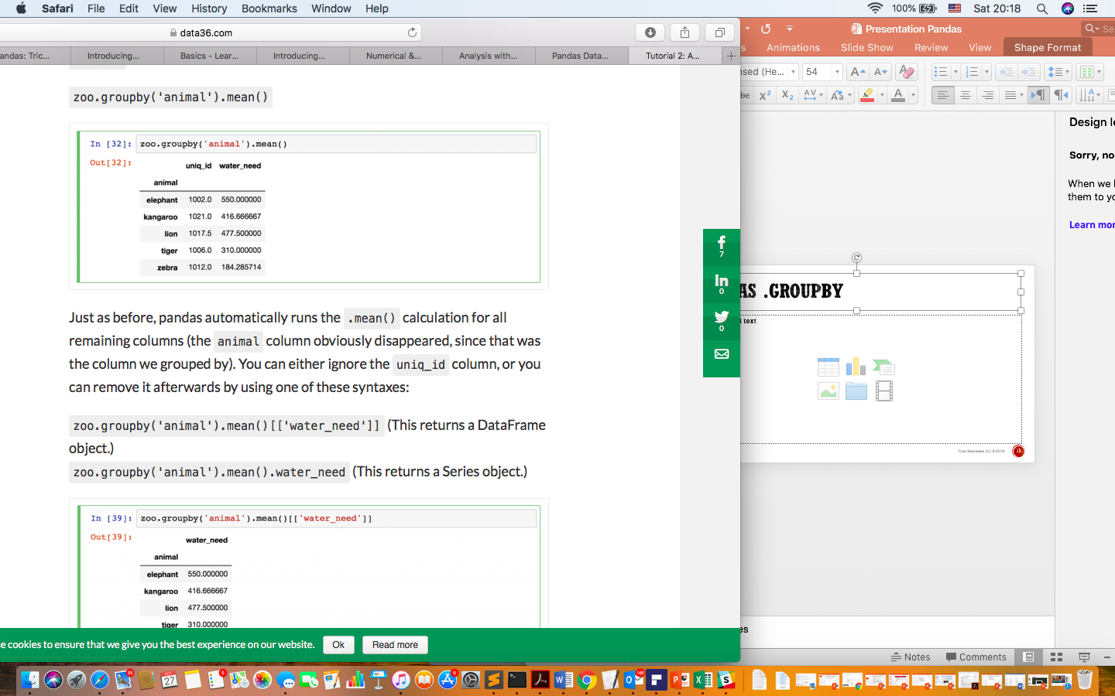
Pandas .groupby
No need for unique_id

Slide 16
Pandas Merge (a.k.a. “joining” dataframes)
We want to merge these two pandas dataframes into one big dataframe.
Lets have two dataframes

Slide 17
where are all the lions?

Slide 18
SQL JOIN types and pandas merge types

Slide 19
Try outer and left

Slide 20
Sorting

Slide 21
Pandas_Cheat_Sheet.pdf
https://github.com/pandas-dev/pandas/blob/master/doc/cheatsheet/Pandas_Cheat_Sheet.pdf
References: The resource of the slides has been taken from “In Coding In Data Science and Analytics” (August 13, 2018)
https://data36.com/pandas-tutorial-1-basics-reading-data-files-dataframes-data-selection/
https://data36.com/pandas-tutorial-2-aggregation-and-grouping/
https://data36.com/pandas-tutorial-3-important-data-formatting-methods-merge-sort-reset_index-fillna/

